Slide 1
Motion Sensor Alarm that calls your Cell Phone when it is tripped (Domain : IOT)
DONE by
RA1811003020100 J.Vignesh
RA1811003020075 M.Yedu krishnan
RA1811003020110 S.Balakrishnan

Slide 2

AGENDA
Abstract
Introduction
Literature survey
Problem statement
Application working
Requirements
Device setup
Code implementation
IFTTT applet
Configuring This and That part in IFTTT applet
Output
Limitations
Conclusion
References

Slide 3

ABSTRACT
This project aims to help the public in protecting and avoiding criminal cases that are likely to occur in their neighborhood. Such cases occur when the occupants are not at home or possibly even occur when the occupants are in the house. Intruders can unlock the house unknowingly by anyone. The Arduino Security System is a technology that uses PIR (Passive Infrared Sensor) sensors to detect such motions.
This device has been created for home security systems. It uses Arduino as a data processor. When the PIR detector detects movement, Arduino processes the data and triggers an alarm. At the same time, when the motion is detected an notification will be sent to the user’s mobile. Only homeowners can turn off the alarm system using a smartphone. The connection between the application and the circuit is connected using a Wi-Fi module. The application of this detector system can be a suitable security system in accordance with the current development.

Slide 4

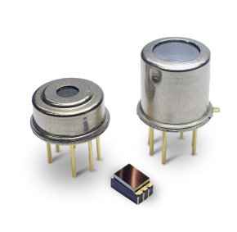


What is IOT ??
The Internet of Things (IoT) describes the network of physical objects—“things”—that are embedded with sensors, software, and other technologies for the purpose of connecting and exchanging data with other devices and systems over the internet.

Slide 5

INTRODUCTION
Crime rates have been increasing lately.
Installing burglar alarm system can protect homes, office premises, warehouses, banks, etc. from burglars and criminals.
Managers and employers are in constant fear that people will gain entry into unauthorized premises and take away with either vital information or goods.
It is, therefore, necessary to install an integrated burglar alarm system to avoid unauthorized premises.

Slide 6
LITERATURE SURVEY
S.No | Authors | Title | Year | Dataset | Drawbacks
1. | K. K. Jena, S. Bhoi, Pabitra Kumar Maharana, Prabhas Ranjan Das, P. K. Senapati | A Smart and Secure Home Automation System Using IoT | 2019 | Home security | Consumes more power , electricity bill will be high.
2. | Sourabh Sarkar ; Srijita Gayen; Saurabh Bilgaiyan | Android Based Home Security Systems Using Internet of Things(IoT) and Firebase | 2018 | Home security | Dependency on internet.

Slide 7
S.No | Authors | Title | Year | Dataset | Drawbacks
3. | Olarewaju .I. K, Ayodele, O. E, Michael. F. O, Alaba. E. S, Abiodun. R. | Design and Construction of an Automatic Home Security System Based on GSM Technology and Embedded Microcontroller Unit. | 2017 | Home security | Licenses are need for GMS technology To increase the coverage repeaters are required to be installed.
4. | Zungeru. A. M, Kolo. J. G, Olumide.I | A Simple and Reliable Touch Sensitive Security System. | 2012 | Security | some basic components for this project is difficult to find. At the implementation stage as the circuit was triggering itself without touching.

Slide 8
S.No | Authors | Title | Year | Dataset | Drawbacks
5. | British Security Industry Association | Journal on security system section strategy for intruder alarm system | 2005 | Industrial security | Some measuring instruments that are being used for detailed analysis of the circuit (i.e. Oscilloscope, Transistor Tester) were limited
6. | Kaur. S, Singh. R, Khairwal. N, and Jain P | Home automation and security system | 2016 | Smart homes | Learning curve on smart home technology can be overwhelming
7. | Bing. Z, Yunhung.G | Home Video Security Surveillance | 2001 | Smart homes | Privacy is an issue It’s expensive to install monitors and camera

Slide 9
S.No | Authors | Title | Year | Dataset | Drawbacks
8. | Prithvi Nath Saranu ; G Abirami ; S Sivakumar ; Kumar M Ramesh ; U Arul ; J Seetha | Theft Detection System using PIR Sensor. | 2018 | Industrial security, home security | When the ambient temperature is close to the human temperature, the detection and sensitivity will drop significantly, and sometimes even a short-term failure will occur.
9. | Deokar Shital Namdeo ; V. R Pawar | IoT based power & security management for smart home system | 2017 | Smart homes | The designing, developing, and maintaining and enabling the large technology to IoT system is quite complicated.
10. | Rocio Garcia-Retamero & Mandeep K. Dhami | Take-the-best in expert-novice decision strategies for residential burglary | 2009 | Theft control | False alarm in many case.

Slide 10

PROBLEM STATEMENT
It’s very difficult for each and every individual to have a constant monitoring of each person who are in same street or area.
And nowadays everyone gets afraid once a new individual or a person who is not from that particular area is roaming in that area, everyone starts thinking who is that person roaming here.. so it is very difficult to keep on judging each and every individual.
The goal of the project is to keep an eye on the burglars and maintain a comfortable and secure life.

Slide 11
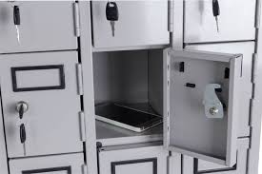
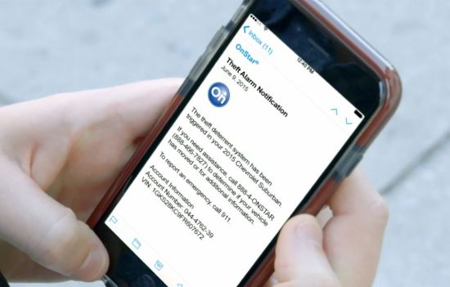
How does the application work ?
Login to the application using ID and password through one’s mobile.
Application will connect to the Arduino MKR WIFI 1010 board.
Then the device should be placed in a secure place which the user wants to protect.
The device has a motion sensor which will detect the motions if there is any.
If there is any motion is detected, a notification will be sent to the mobile.

Slide 12
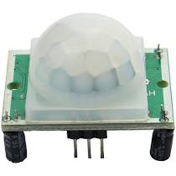
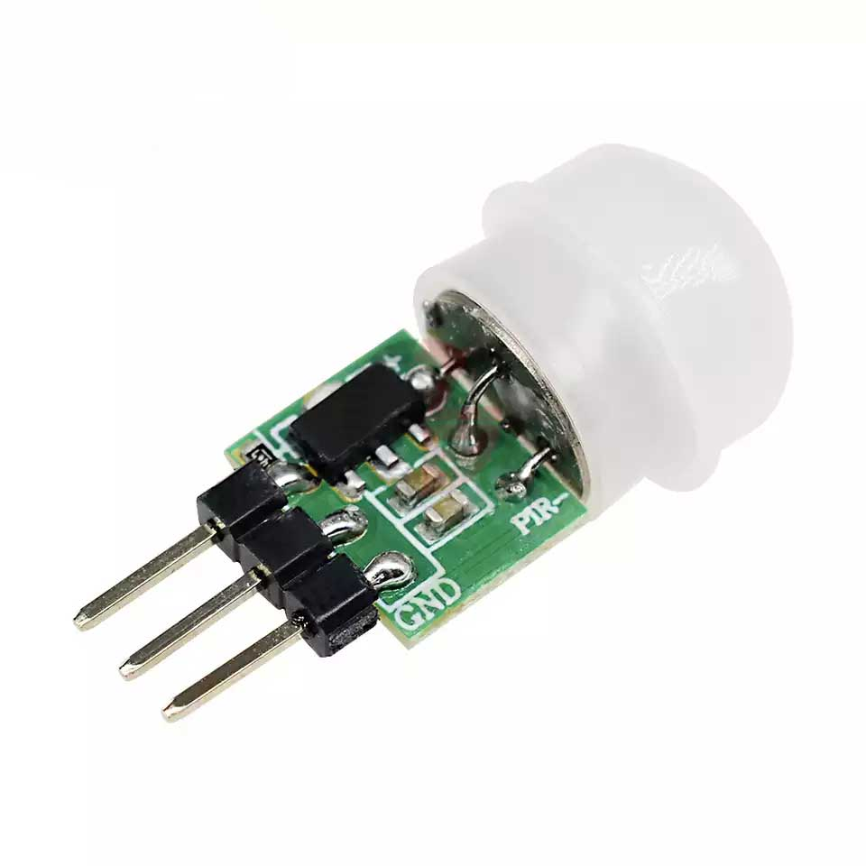
PIR sensor
A Passive Infrared sensor (PIR sensor) is an electronic device that measures infrared (IR) light radiating from objects in its field of view.
Apparent motion is detected when an infrared source with one temperature, such as a human, passes in front of an infrared source.

Slide 13
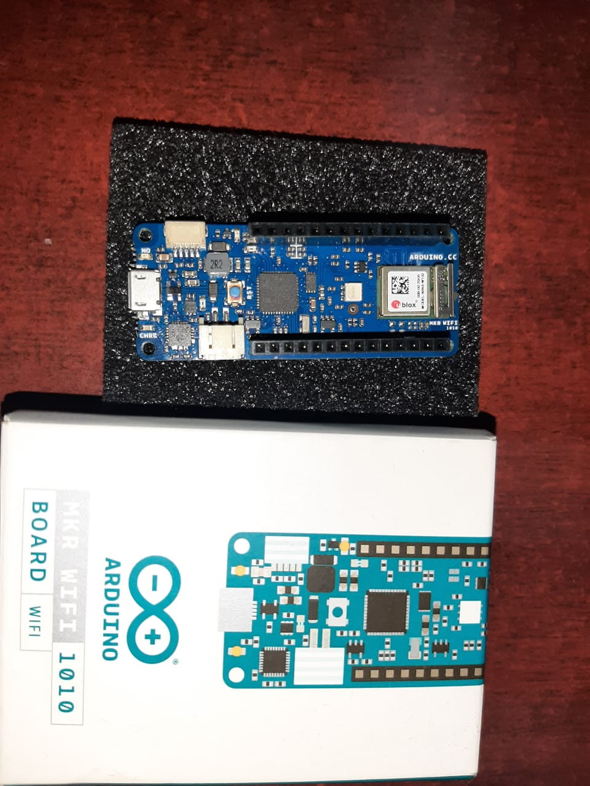
What is a Arduino ?
Arduino is an open-source platform used for building electronics projects.
You can tell your board what to do by sending a set of instructions to the microcontroller on the board.

Slide 14
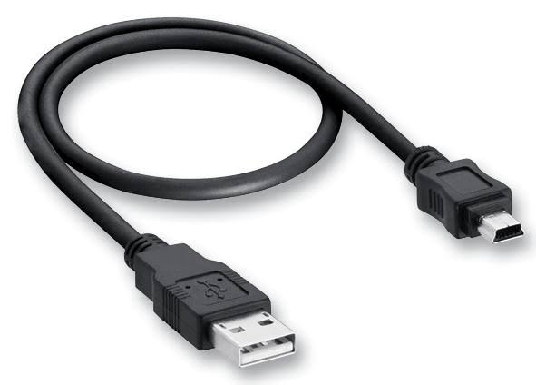
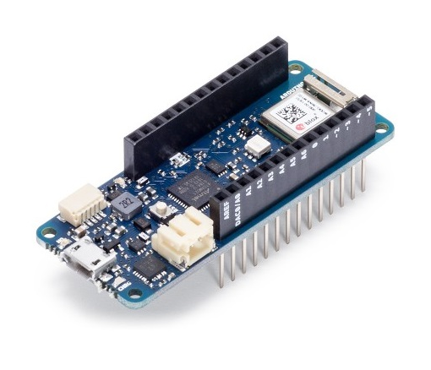
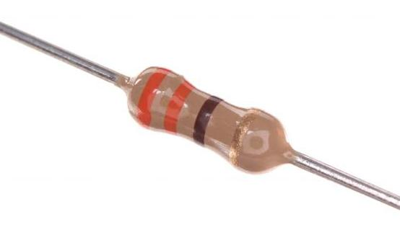
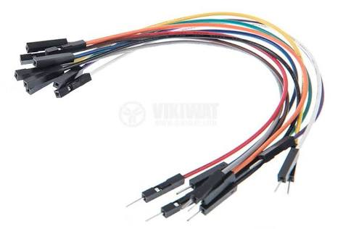
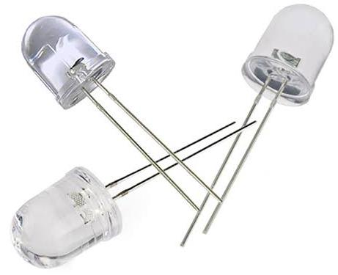
REQUIREMENTS
Arduino MKR WIFI 1010 Board (or compatible board)
USB Cable
Connecting wires
PIR Sensor
330 Ω resistor
LED

Slide 15
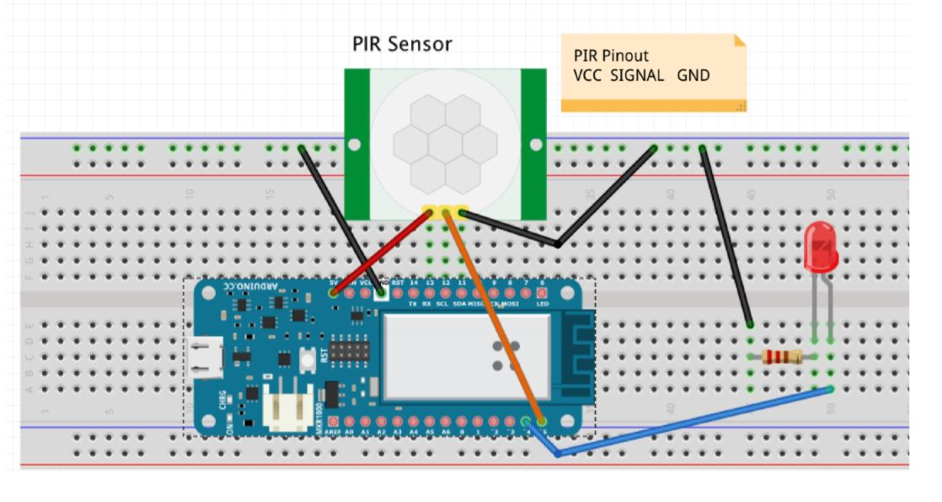
DEVICE SET-UP

Slide 16
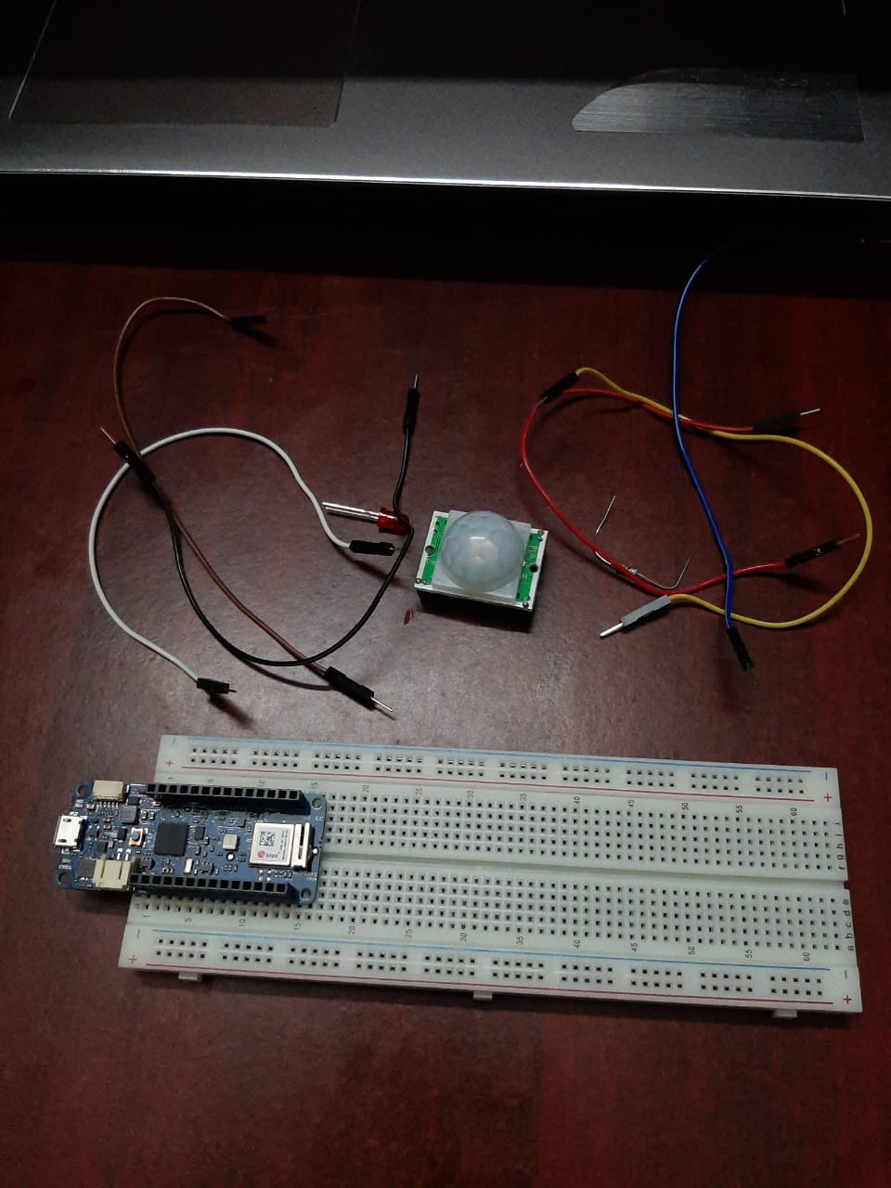
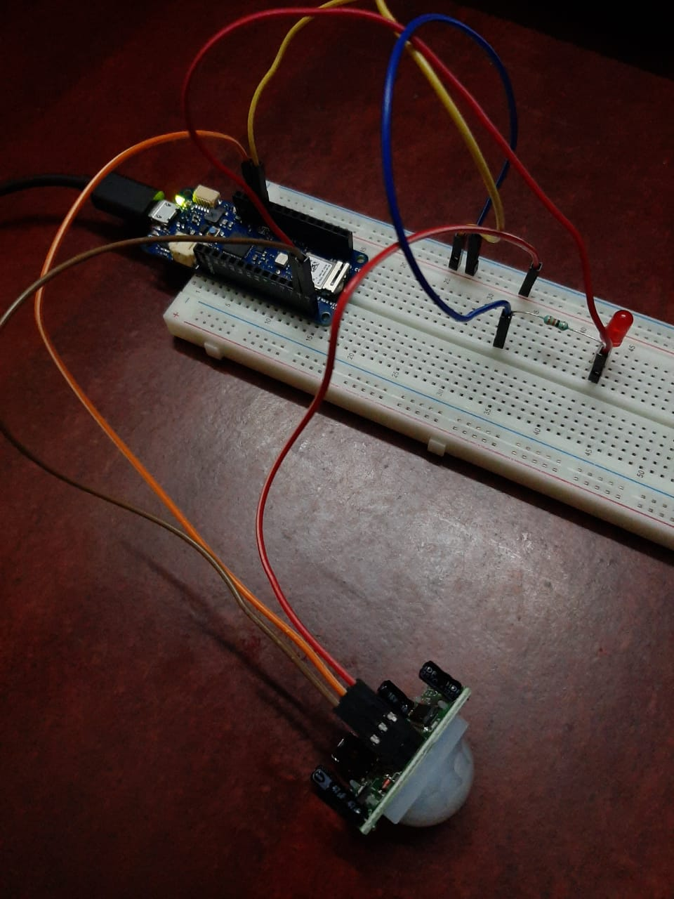
IMPLEMENTATION
Before
After

Slide 17
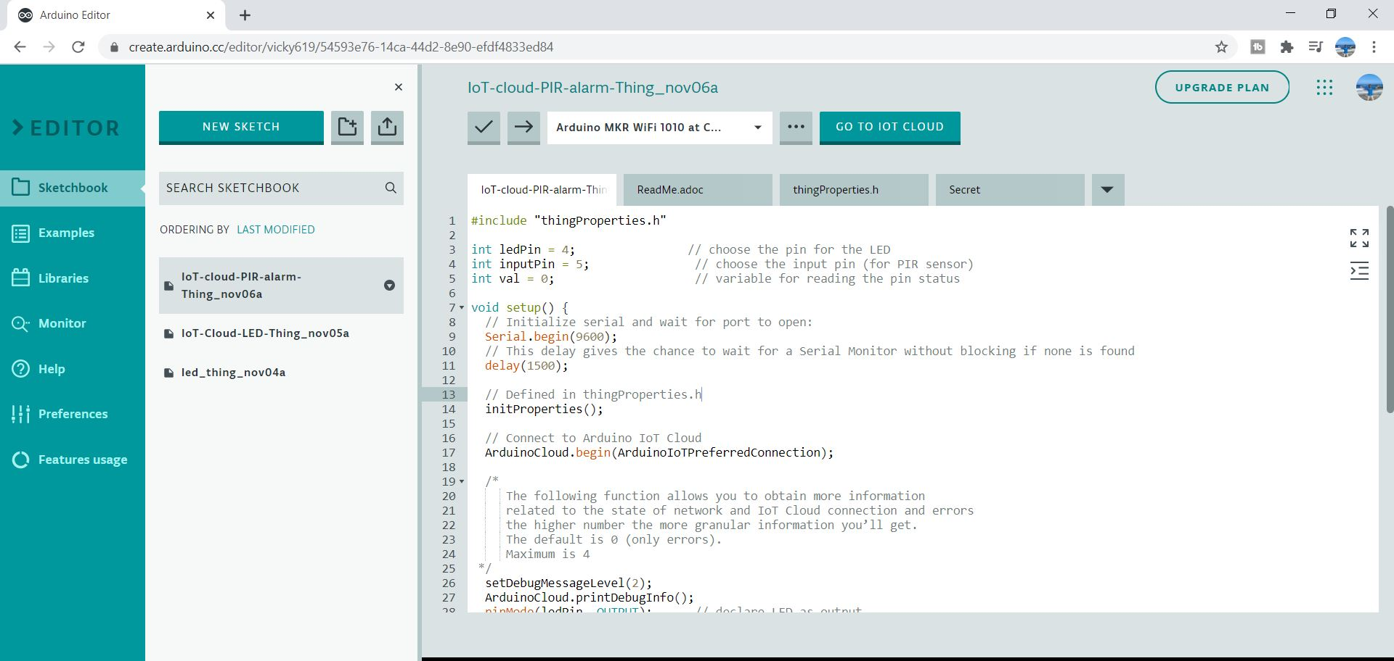
CODE IMPLEMENTATION

Slide 18
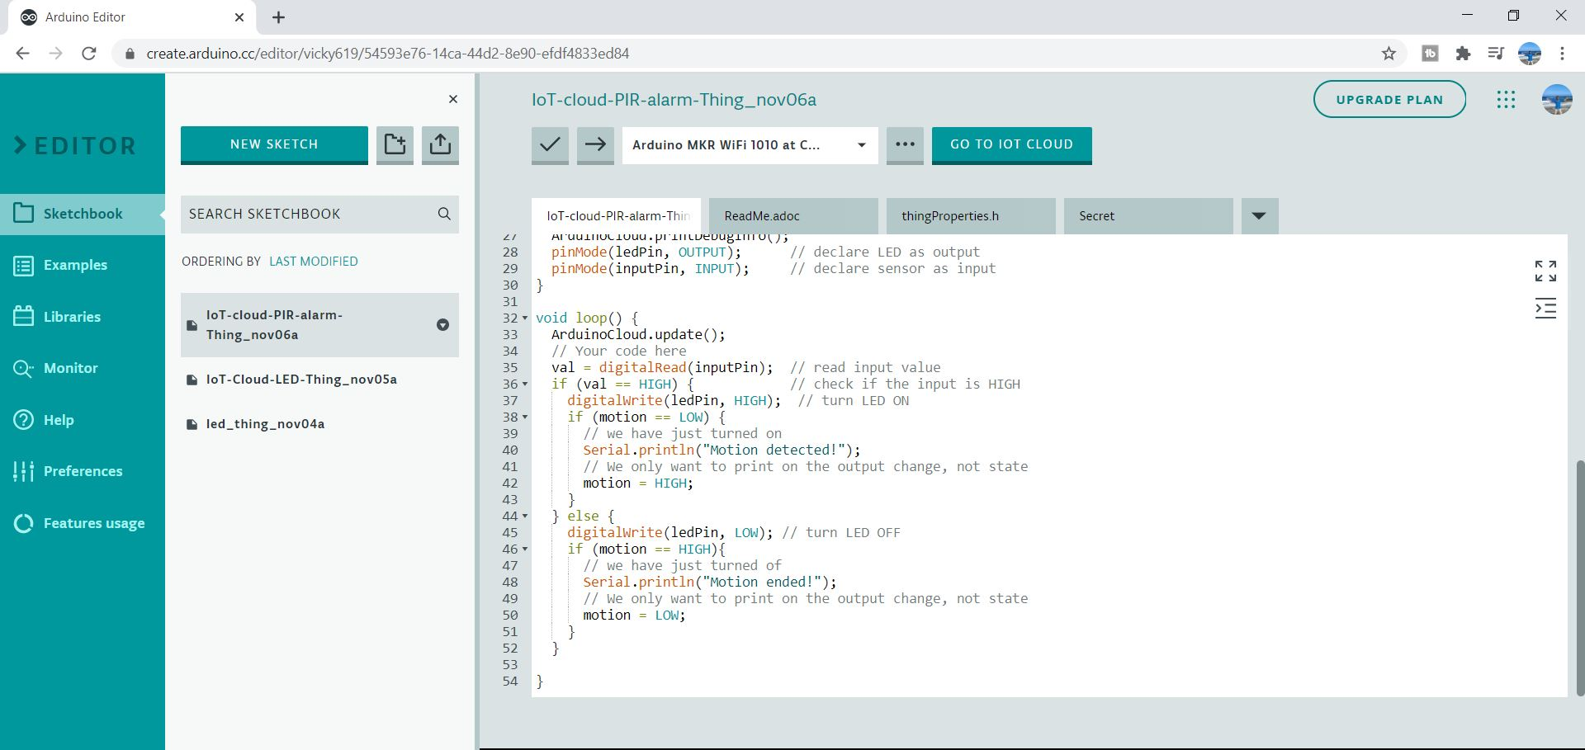

Slide 19

IFTTT APPLET
The acronym stands for If This, Then That.
An Applet connects two or more apps or devices together.
We use IFTTT Applet to connect our Arduino and our mobile together.
When the motion is detected notification will be sent to the mobile.

Slide 20

Creating an Webhook to IFTTT
Create an IFTTT account in your PC.
Connect an Webhook in the IFTTT web hook integration page.
Then, go to custom applet page and click on new Applet.

Slide 21

Then we have to configure That part
First we have to configure if part

Slide 22
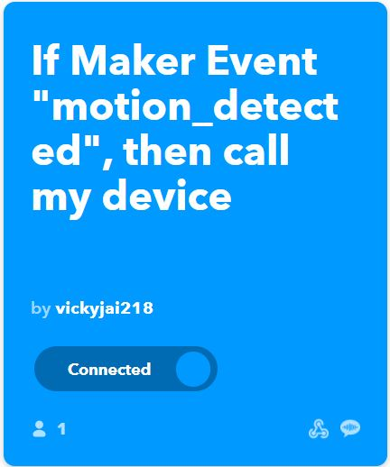
Configuring This and That part
Add an webhook in the This part which will connect the Arduino.
Install IFTTT app in mobile.
Then, add VoIP calls in the That part which will connect Arduino and mobile. When an apparent motion is detected notification will be sent to the mobile.

Slide 23
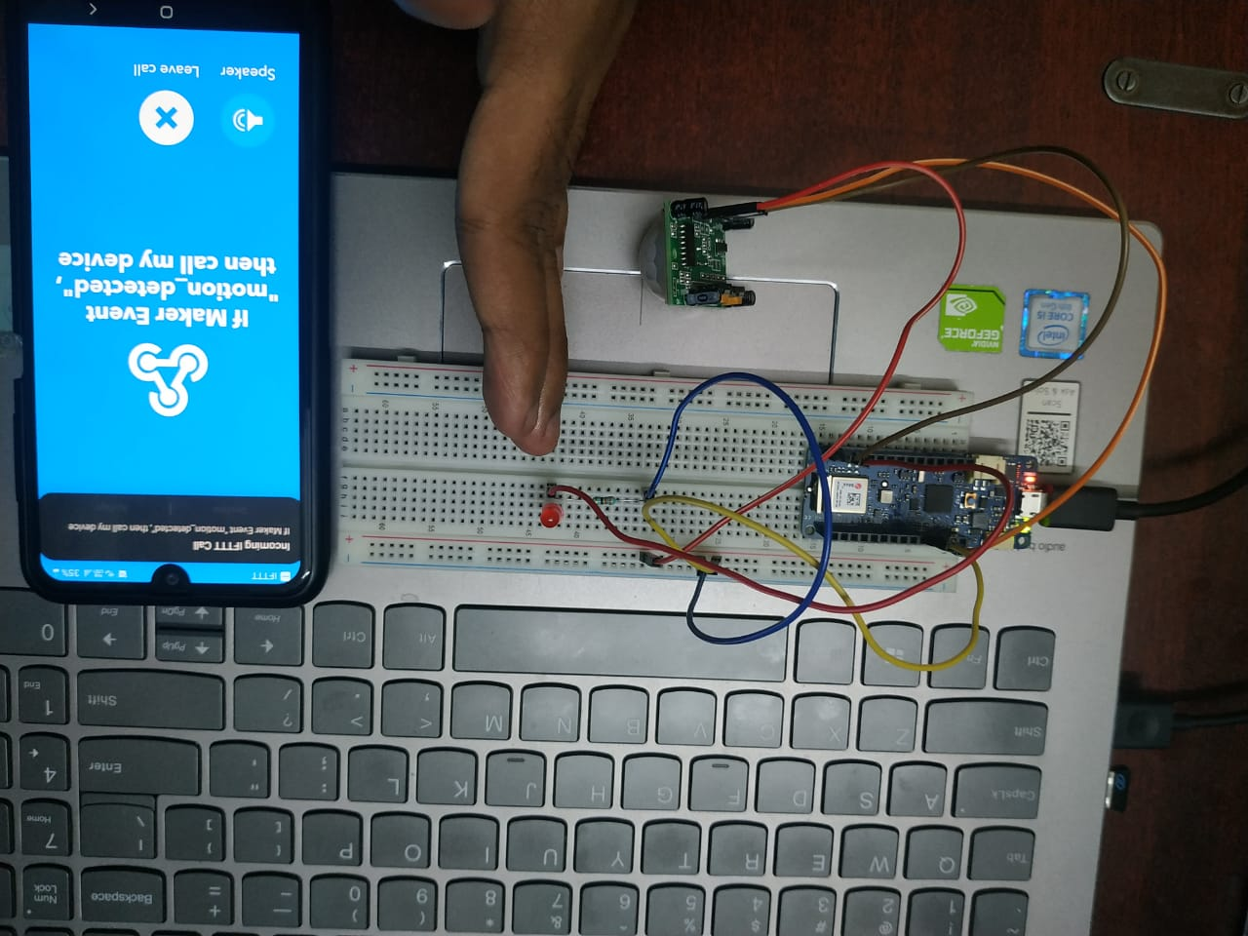
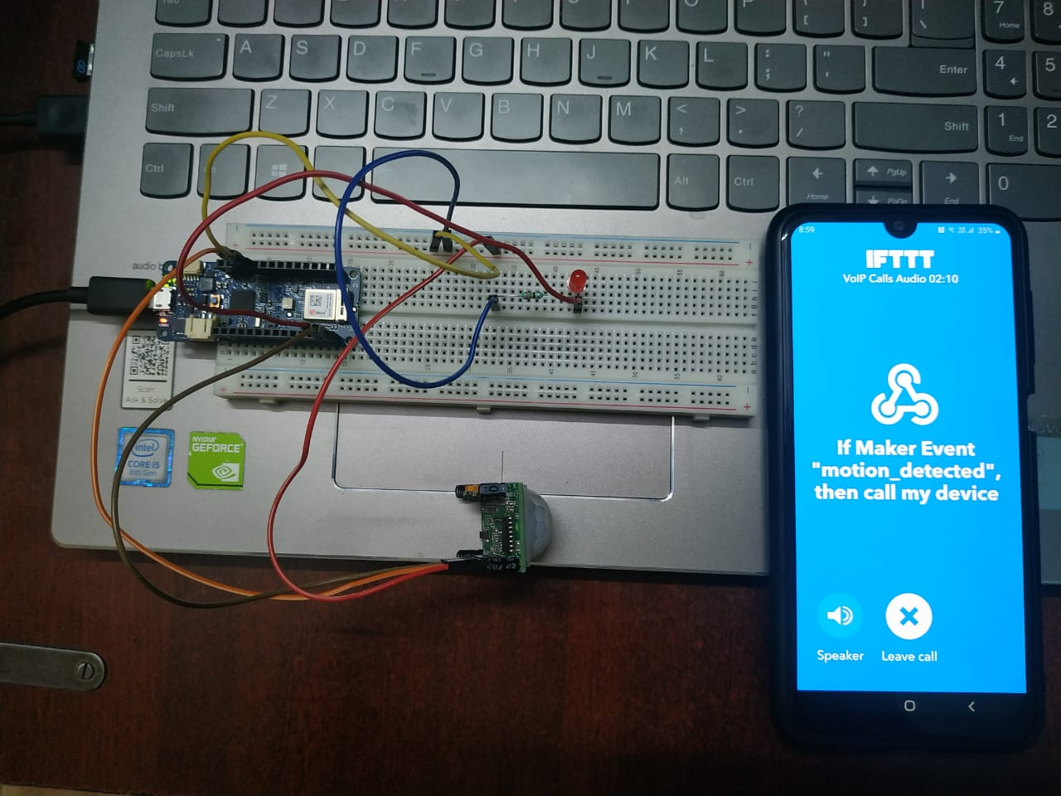
OUTPUT
Motion sensor alarm is built successfully

Slide 24
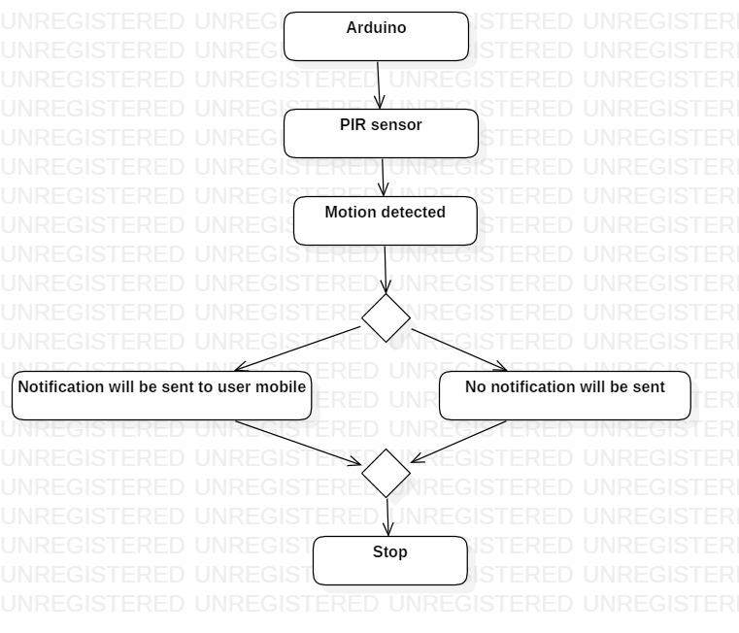
MODULE EXPLANATION
PIR sensor is connected to the Arduino .
If motion is detected :
The user will receive an alert to his mobile. Which will indicate unwanted person has crossed through the PIR sensor.
If no motion is detected :
The user will not receive any notification. Which will indicate no person has crossed through the PIR sensor.
yes
no

Slide 25
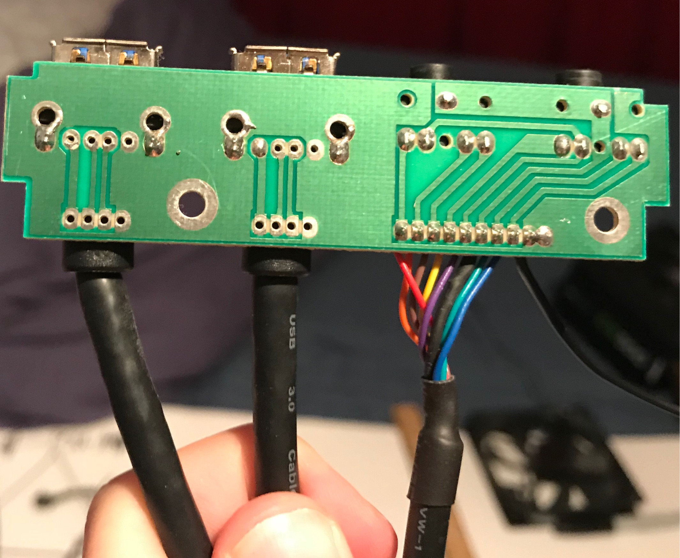

LIMITATIONS
Device would detect any movement which may or may not be burglary.
Bugs in code.
Security systems may not work during power outages.

Slide 26

CONCLUSION
This work focuses on the design of a smart and secure home automation system using IoT devices. This system can help the elder and disabled persons for maintaining a comfortable and secure life.
This is operated using IFTTT Applet.

Slide 27
REFERENCES
https://www.safewise.com/home-security-faq/how-do-security-systems-work/
Zungeru. A. M, Kolo. J. G, Olumide. I, September 2012. “A Simple and Reliable Touch Sensitive Security System”, International Journal of Network Security & Its Application
British Security Industry Association (BISA), “Journal on security system section strategy for intruder alarm system”, Page 1-3, April 2005
“History of Security Alarms”, http://www.icee.org/organization/history center/fire alarm.html
Hasan. R, Khan. M. M, Ashek. A Rumpa. I. J, 2015, “Microcontroller Based Home Security System with GSM Technology” Open Journal of Safety Science and Technology, Vol.5, pp. 55-62, Published Online in SciRes. http://www.scirp.org/journal/ojsst

Slide 28


